Slide 1


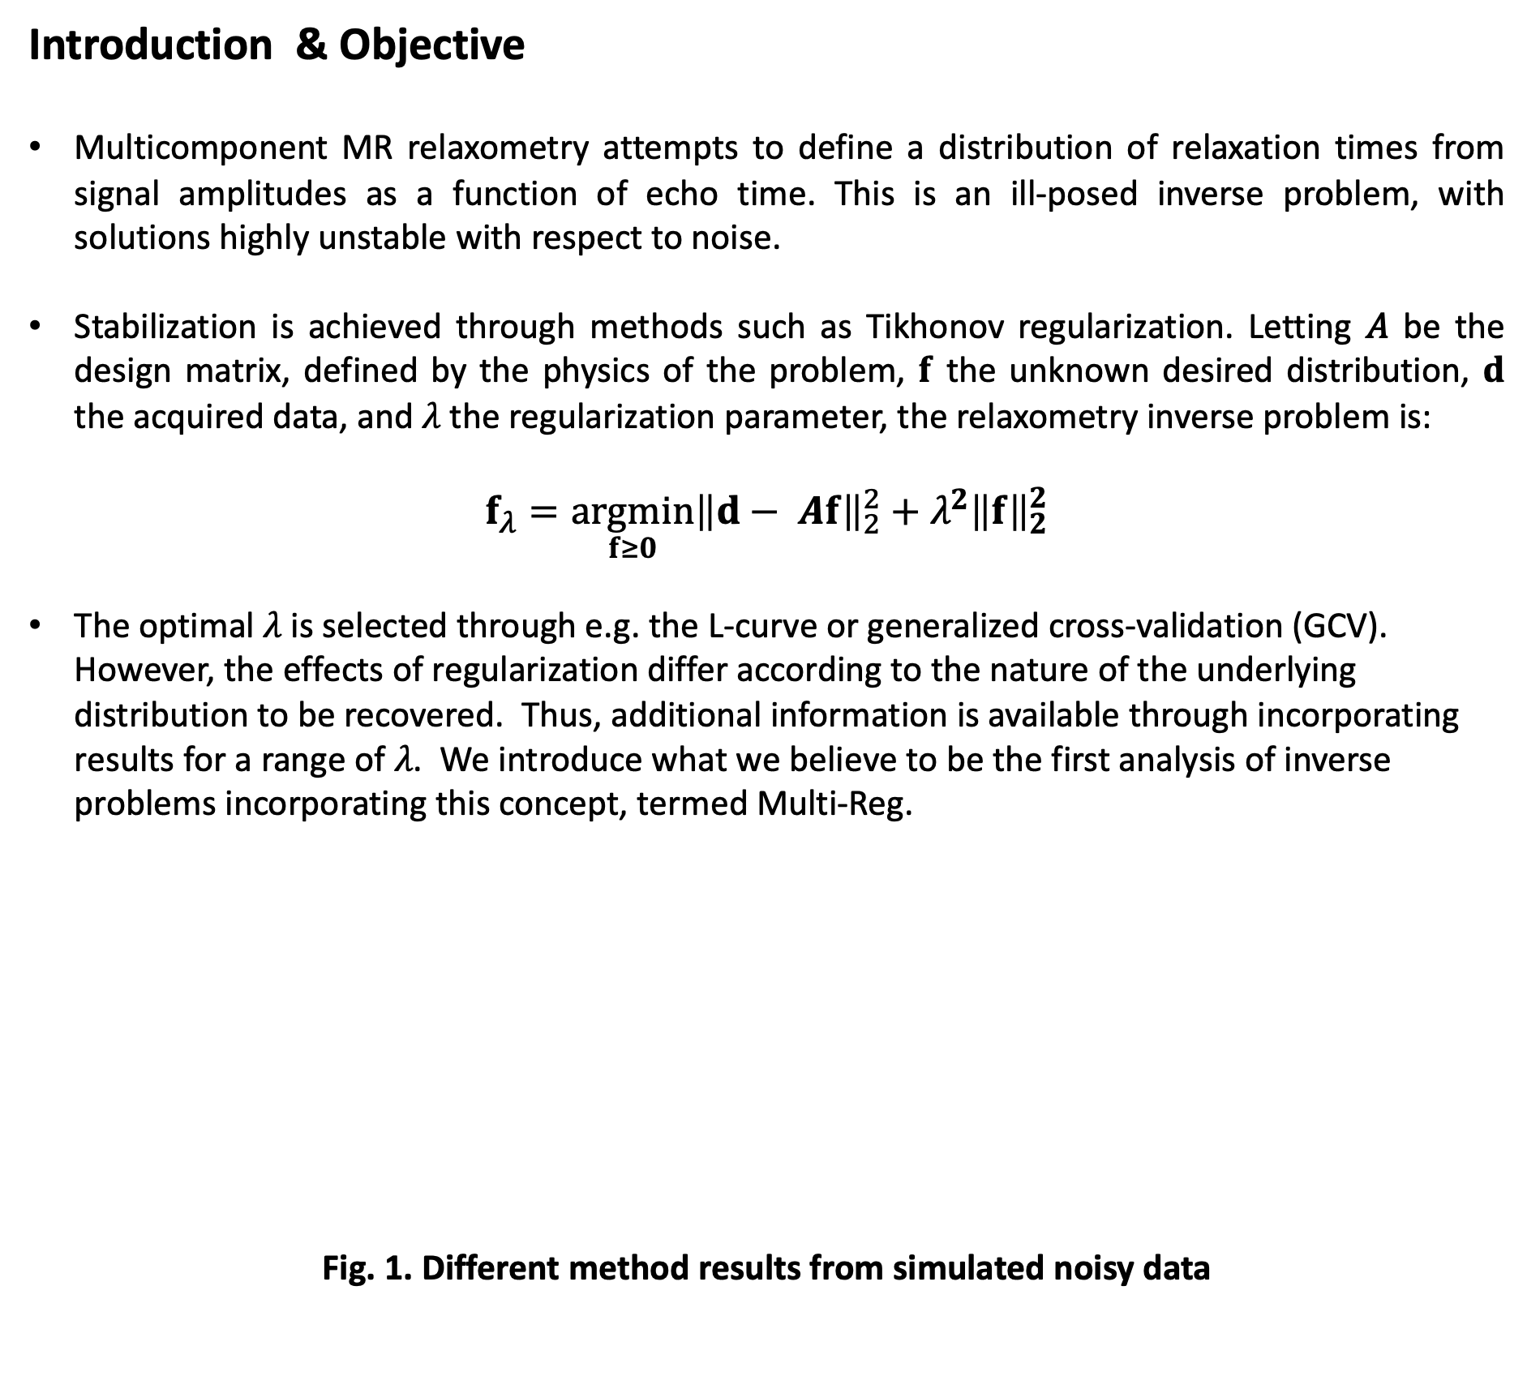
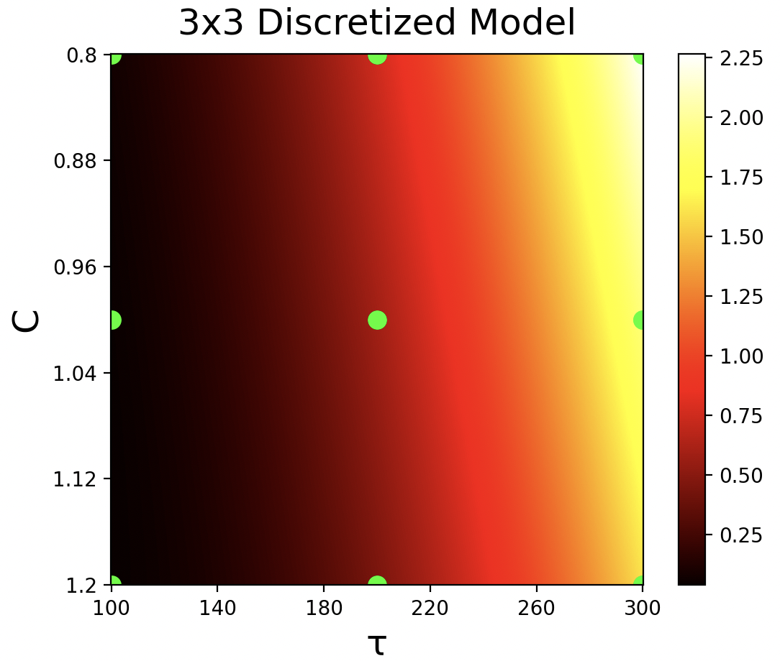
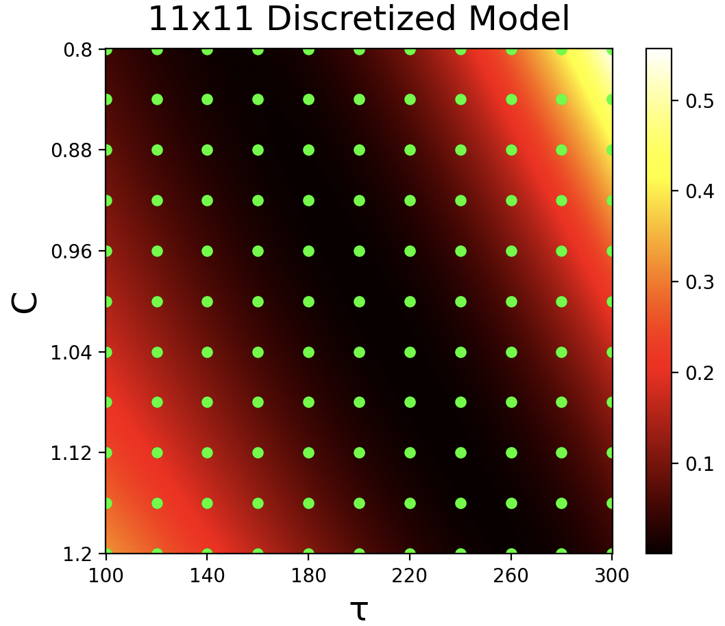
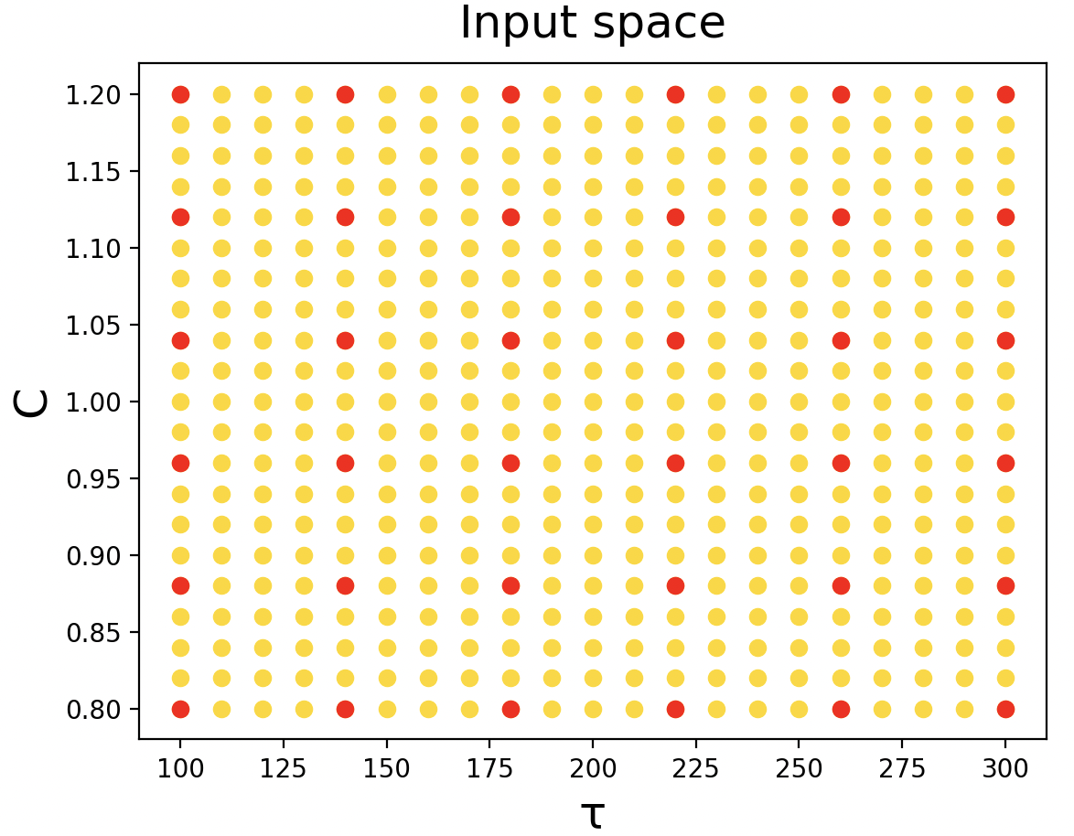
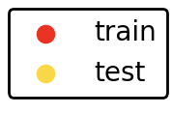
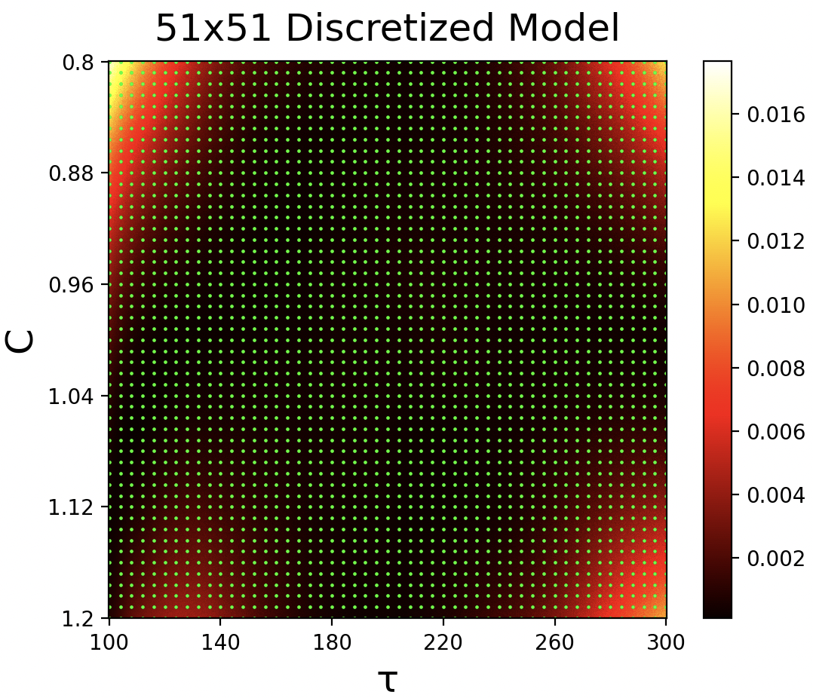
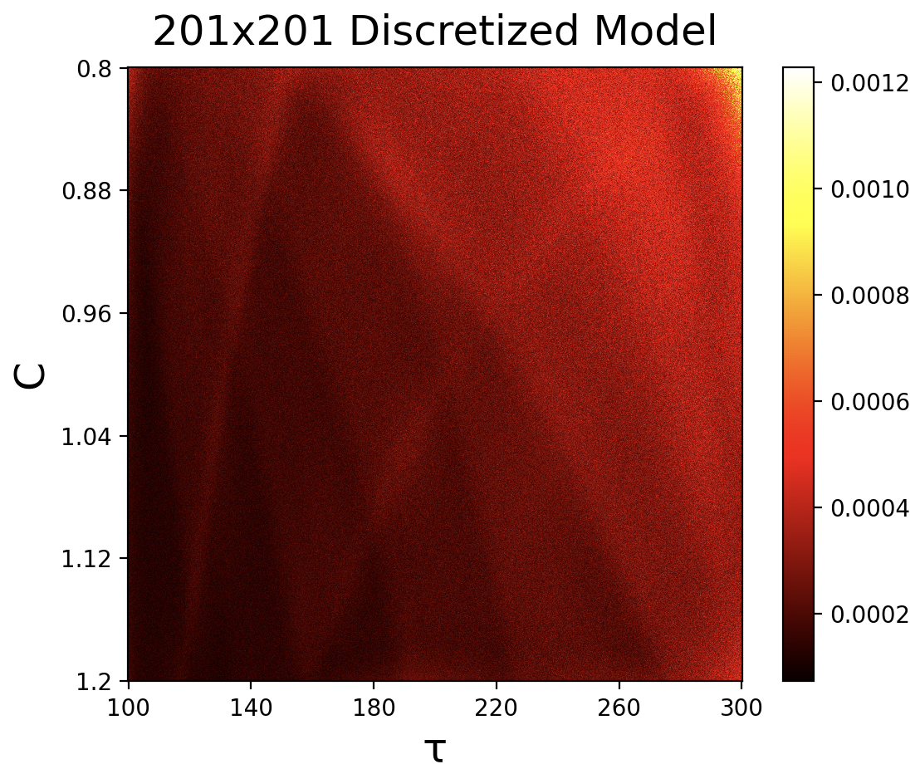
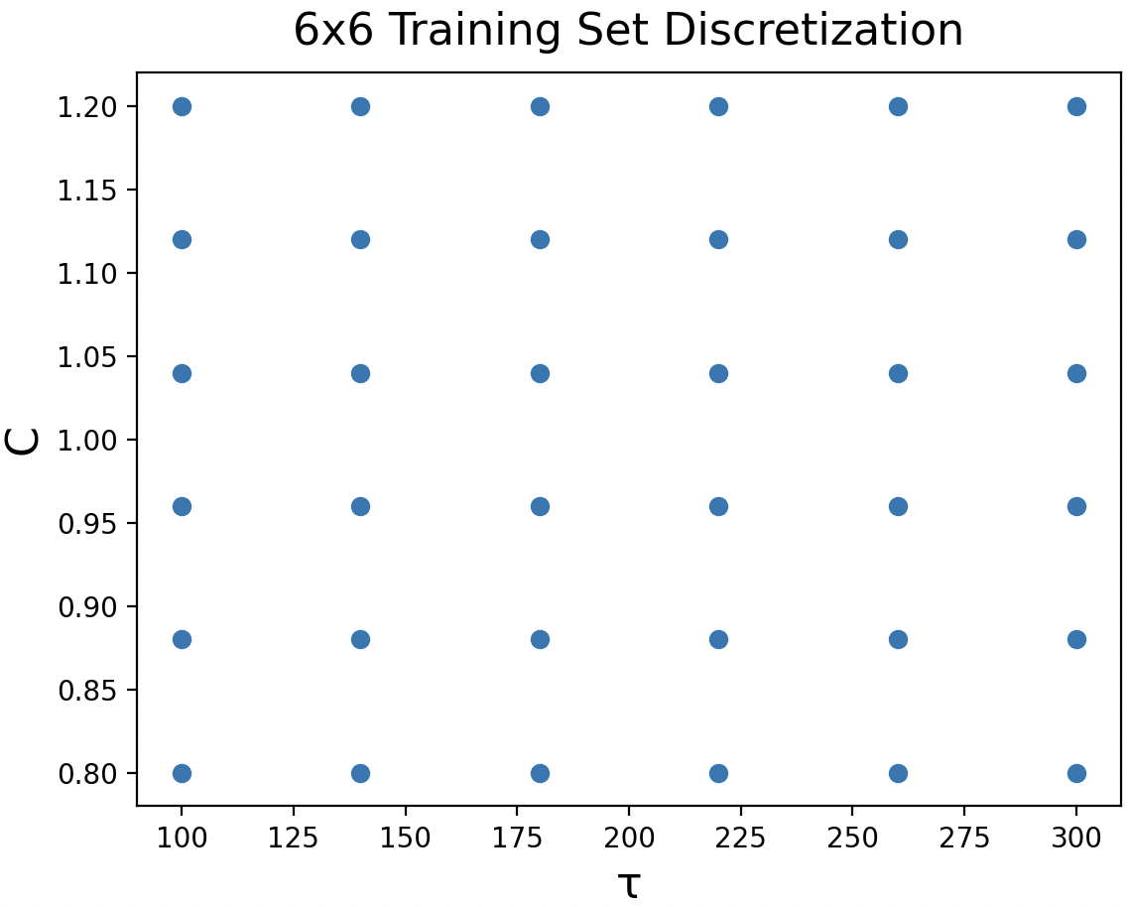
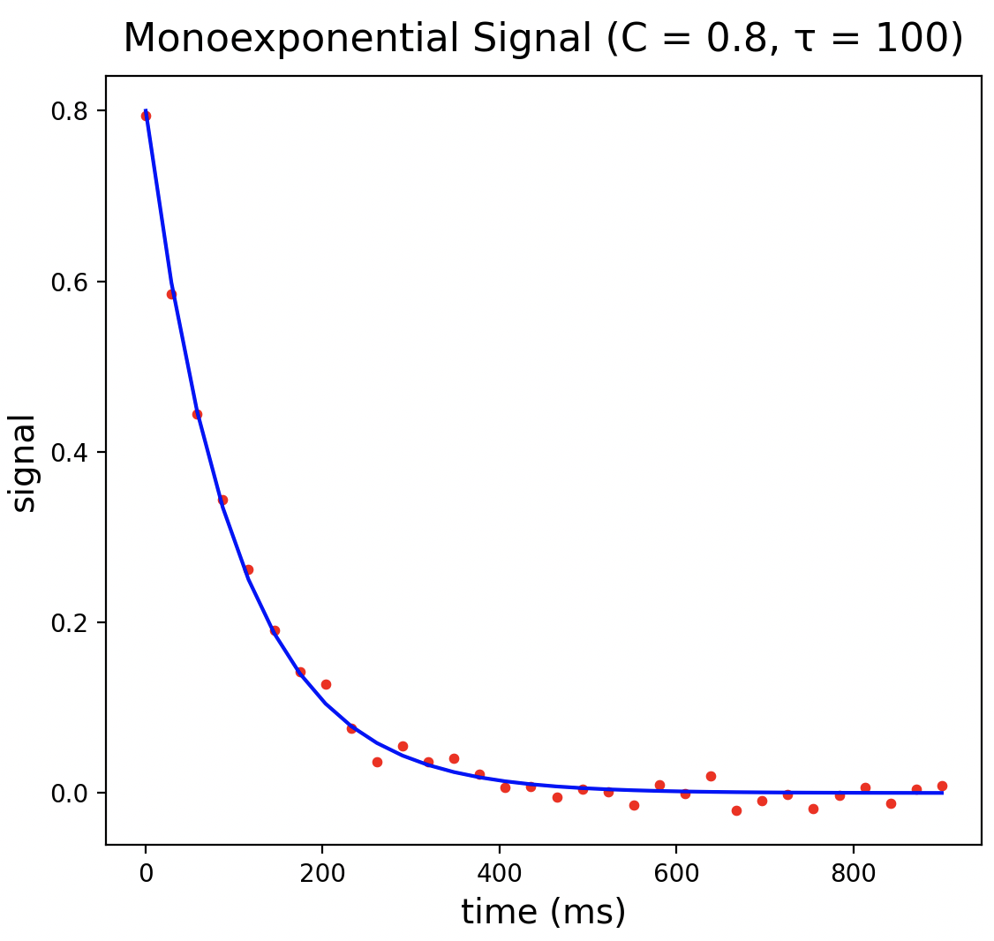
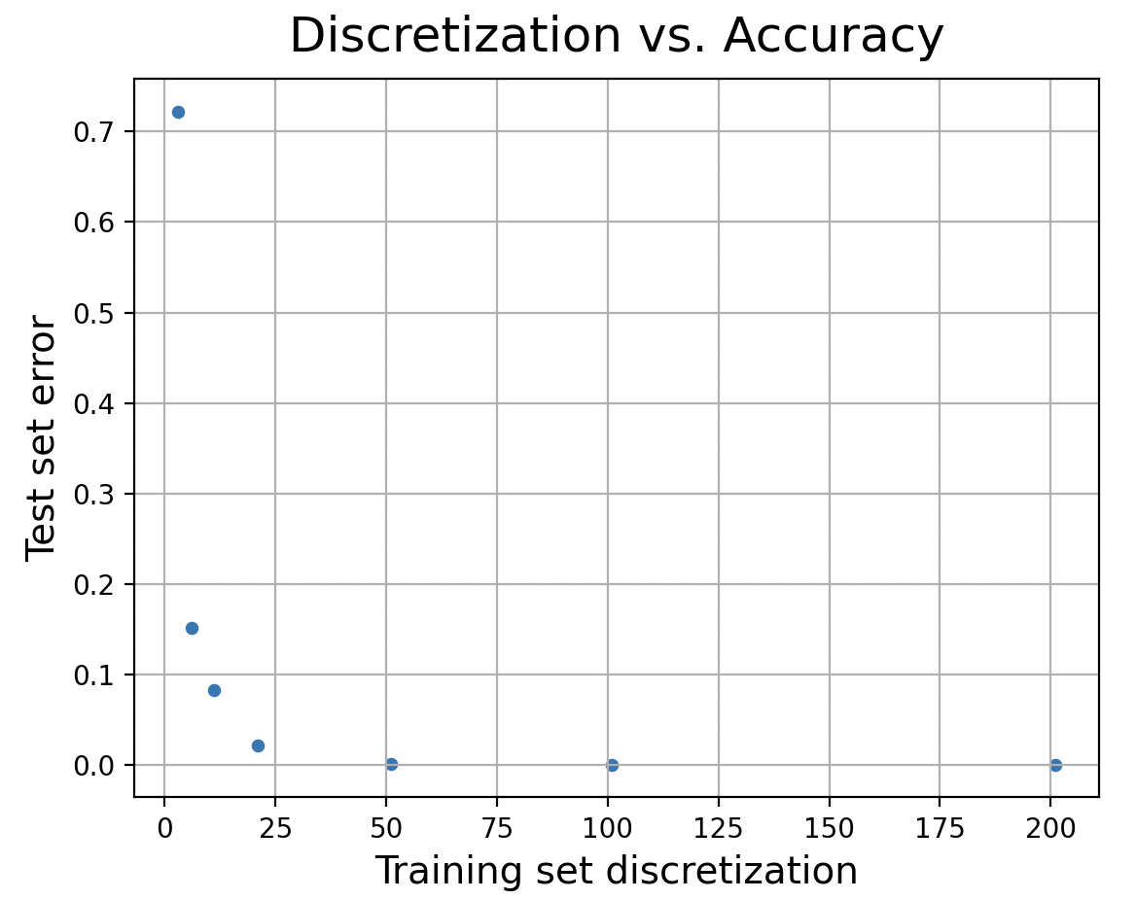
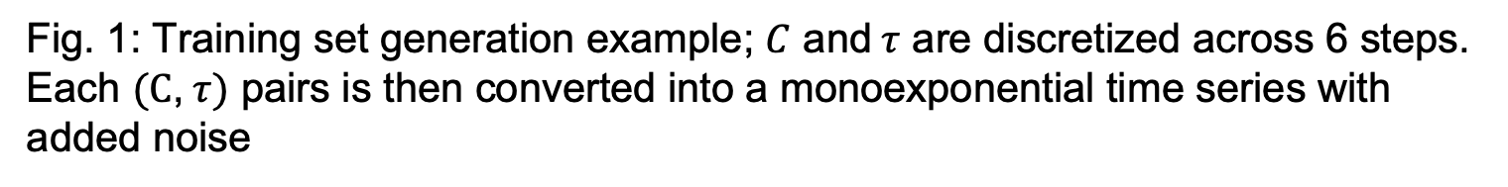
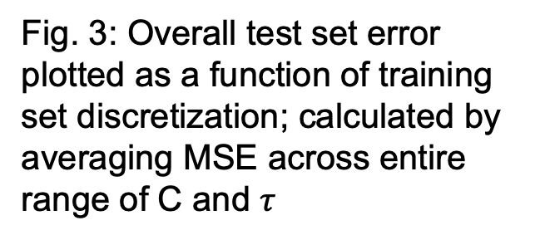
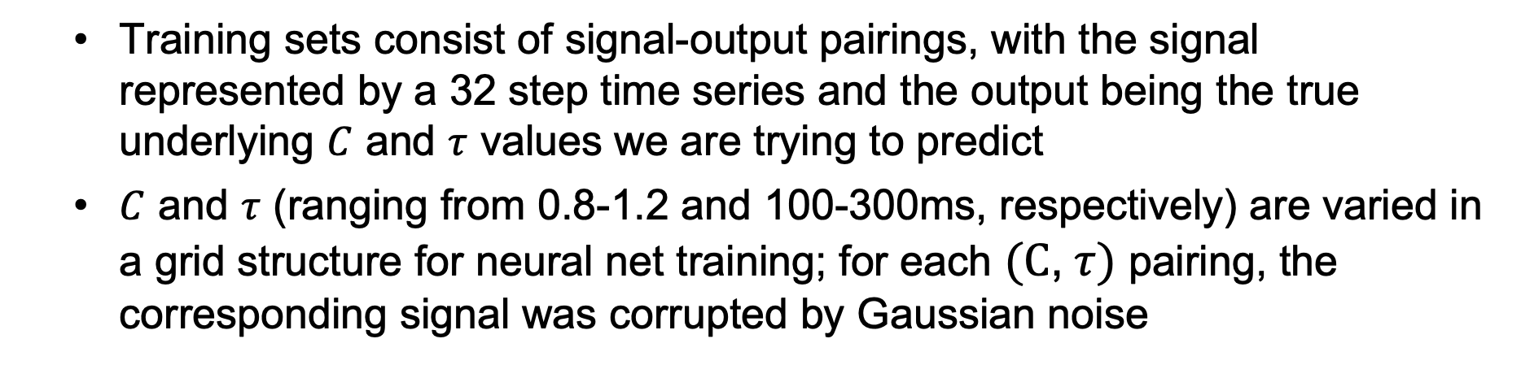
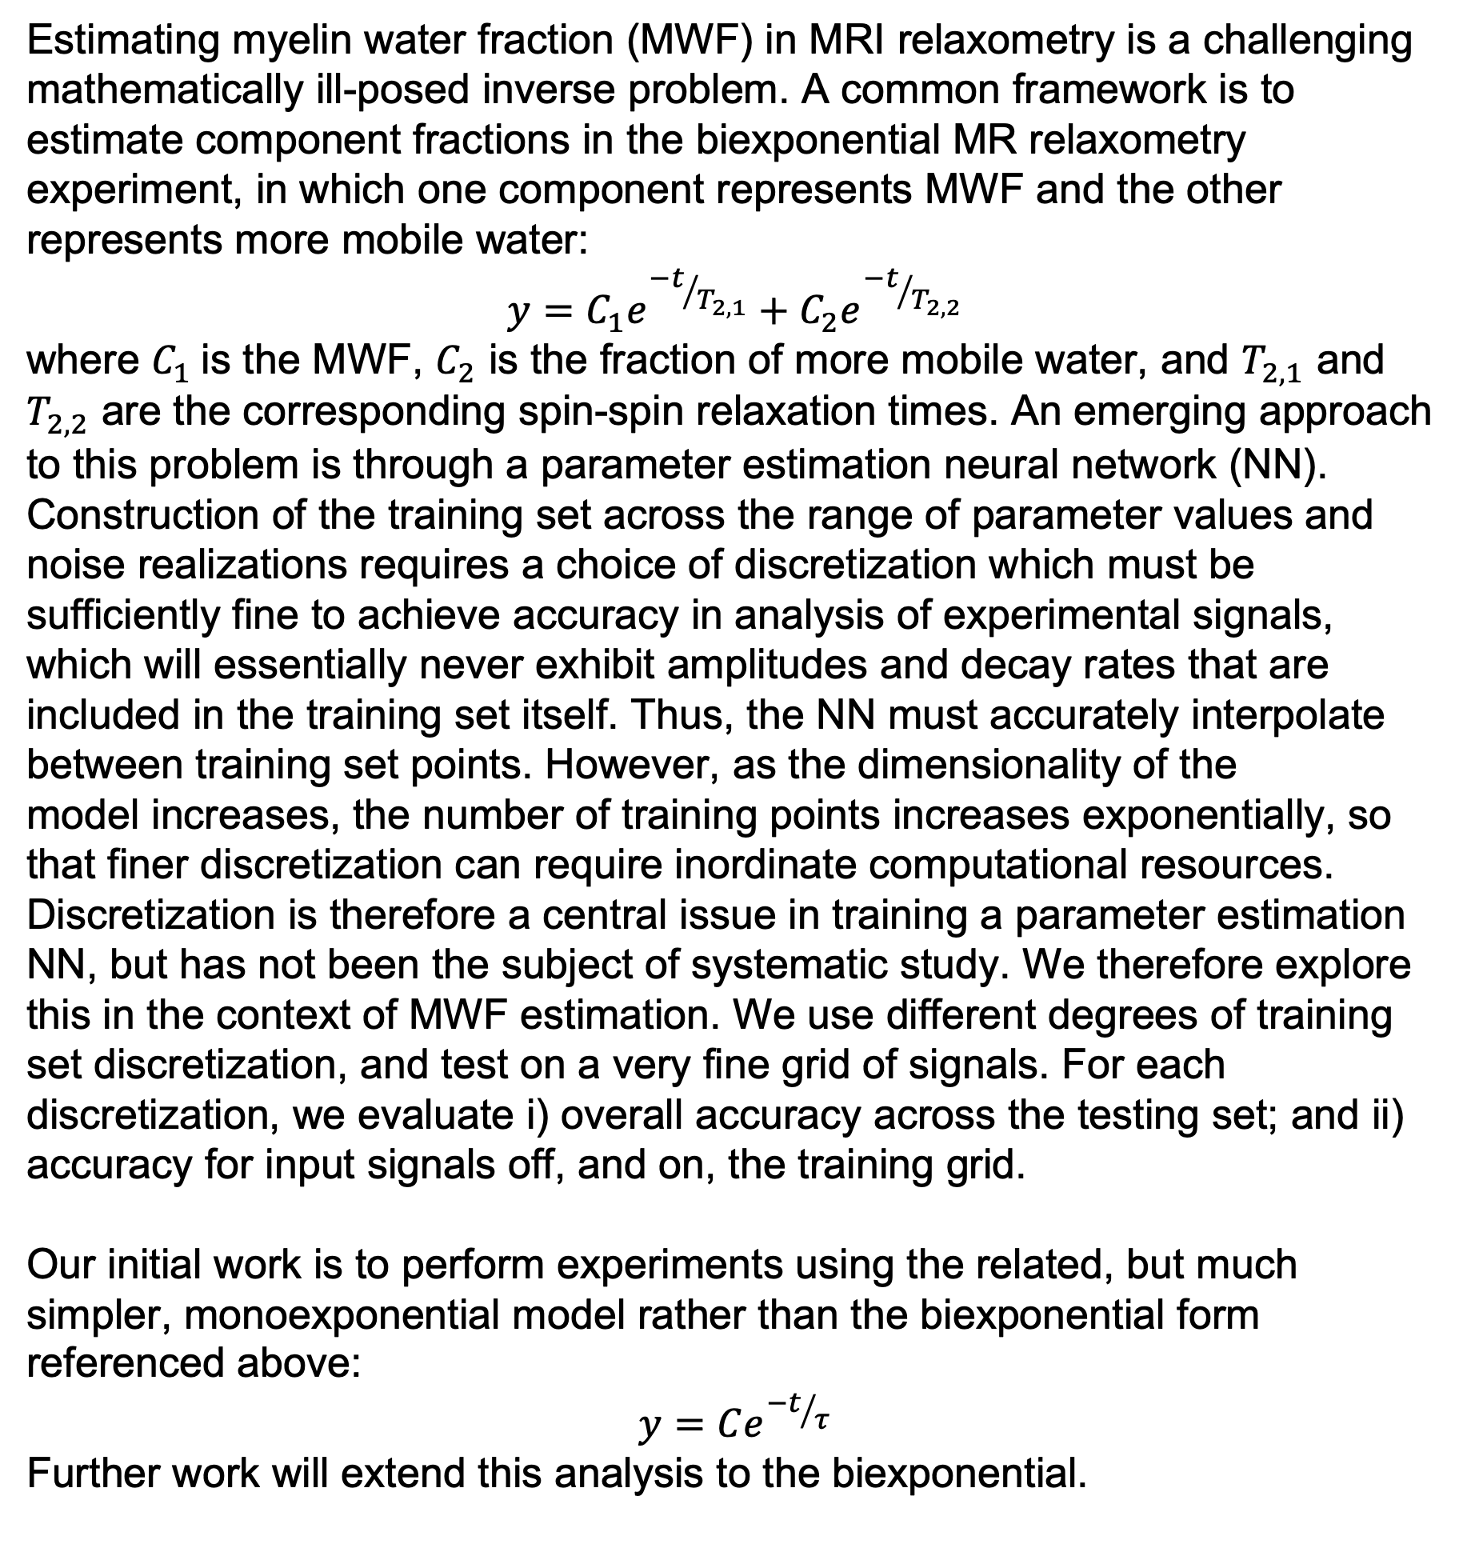
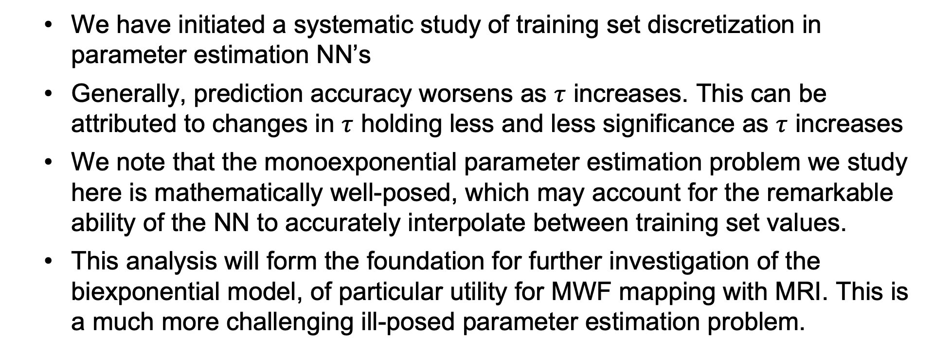
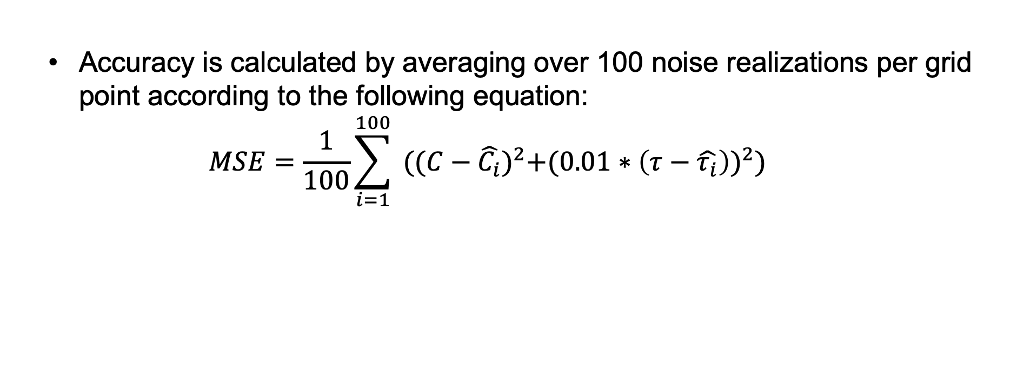
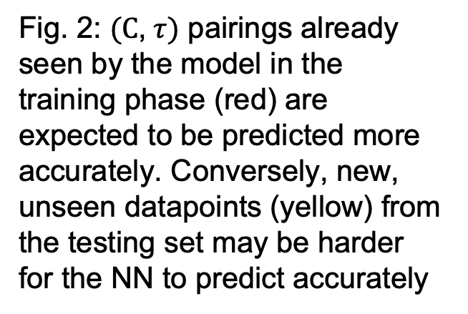
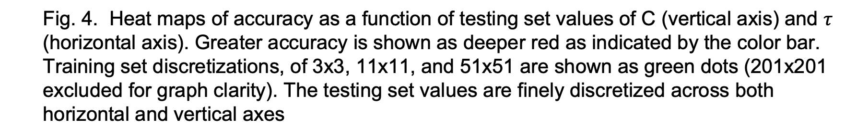
Effect of training set discretization on neural network estimation of myelin water fraction from the biexponential relaxometry model
Aaron Lee, Rajib Chowdhury, and Richard G. Spencer
Magnetic Resonance Imaging and Spectroscopy Section, Laboratory of Clinical Investigation, National Institute On Aging,
National Institutes of Health, Baltimore, United States
Introduction
Hypothesis
Results
Estimating myelin water fraction (MWF) in MRI relaxometry is a challenging mathematically ill-posed inverse problem. A common framework is to estimate component fractions in the biexponential MR relaxometry experiment, in which one component represents MWF and the other represents more mobile water:
$$y=C_{1}e^{{−t}/{T_{2,1}}}+C_{2}e^{{−t}/{T_{2,2}}}$$
where $C_{1}$is the MWF, $C_{2}$ is the fraction of more mobile water, and $T_{2,1}$ and $T_{2,2}$ are the corresponding spin-spin relaxation times. An emerging approach to this problem is through a parameter estimation neural network (NN). Construction of the training set across the range of parameter values and noise realizations requires a choice of discretization which must be sufficiently fine to achieve accuracy in analysis of experimental signals, which will essentially never exhibit amplitudes and decay rates that are included in the training set itself. Thus, the NN must accurately interpolate between training set points. However, as the dimensionality of the
model increases, the number of training points increases exponentially, so that finer discretization can require inordinate computational resources. Discretization is therefore a central issue in training a parameter estimation NN, but has not been the subject of systematic study. We therefore explore this in the context of MWF estimation. We use different degrees of training set discretization, and test on a very fine grid of signals. For each discretization, we evaluate i) overall accuracy across the testing set; and ii) accuracy for input signals off, and on, the training grid.
Our initial work is to perform experiments using the related, but much simpler, monoexponential model rather than the biexponential form referenced above:
$$y=Ce^{{−t}/τ}$$
Further work will extend this analysis to the biexponential.
The grid is discretized at different levels to create several training sets, starting from 3x3 and going to 201x201
A testing set of much finer discretization (1001x1001) is generated to test the resulting NN’s
Fig. 2: $(C$,$τ)$ pairings already seen by the model in the training phase (red) are expected to be predicted more accurately. Conversely, new, unseen datapoints (yellow) from the testing set may be harder for the NN to predict accurately
We hypothesized the NN’s will show greater accuracy on testing set values corresponding to the training set, while performing worse on unseen data points
The NN’s were expected to perform better overall with increased training set discretization
Neural Network Training
Fig. 4. Heat maps of accuracy as a function of testing set values of C (vertical axis) and $τ$ (horizontal axis). Greater accuracy is shown as deeper red as indicated by the color bar. Training set discretizations, of 3x3, 11x11, and 51x51 are shown as green dots (201x201 excluded for graph clarity). The testing set values are finely discretized across both horizontal and vertical axes
Dataset Generation
NN’s are trained for each training set until convergence is reached
Table 1. Training times for each model
Disc. Level | 3x3 | 6x6 | 11x11 | 21x21 | 51x51 | 101x101 | 201x201
Train Epochs | 300 | 180 | 100 | 70 | 50 | 35 | 25
As seen above, within each heat map, accuracy is independent of whether the testing data is on or off a training set grid point
Overall accuracy did improve with increased training set discretization (Fig. 3) up to a certain extent, beyond which accuracy remained essentially constant.
Training sets consist of signal-output pairings, with the signal represented by a 32 step time series and the output being the true underlying $C$ and $τ$ values we are trying to predict
$C$ and $τ$ (ranging from 0.8-1.2 and 100-300ms, respectively) are varied in a grid structure for neural net training; for each $(C$,$τ)$ pairing, the corresponding signal was corrupted by Gaussian noise
Accuracy is calculated by averaging over 100 noise realizations per grid point according to the following equation:
$$MSE=\frac{1}{100}\sum_{i=1}^{100}{{ ((C−\hat{C_{i}})}^{2}+{(0.01∗\left(τ−\hat{τ_{i}}\right))}^{2})}$$
Discussion and Future Research
6x6 Training Set Discretization
We have initiated a systematic study of training set discretization in parameter estimation NN’s
Generally, prediction accuracy worsens as $τ$ increases. This can be attributed to changes in $τ$ holding less and less significance as $τ$ increases
We note that the monoexponential parameter estimation problem we study here is mathematically well-posed, which may account for the remarkable ability of the NN to accurately interpolate between training set values.
This analysis will form the foundation for further investigation of the biexponential model, of particular utility for MWF mapping with MRI. This is a much more challenging ill-posed parameter estimation problem.
where $C$ and $τ$ represent the true parameter values, and $\hat{C_{i}}$ and $\hat{τ_{i}}$ represent the predicted parameters for the $i$th noise realization
Fig. 3: Overall test set error plotted as a function of training set discretization; calculated by averaging MSE across entire range of C and $τ$
References
Fig. 1: Training set generation example; $C$ and $τ$ are discretized across 6 steps. Each $(C$,$τ)$ pairs is then converted into a monoexponential time series with added noise
C. M. Bishop, C. M. Roach, Fast curve fitting using neural networks, Rev. Sci. Instrum., Vol. 63, No. 10, October 1992
M. Rozowski, J. Palumbo, J Bisen, C. bi, M. Bouhrara, W, Czaja, R. G. Spencer, Input layer regularization for magnetic resonance relaxometry biexponential parameter estimation. Magn Reson Chem. November 2022

